Slide 2
A Scalable Producer-Consumer Pool Based on Elimination –Diffraction Trees
Clayton Barham & Anthony Dinh

Slide 4
Intro

Slide 5
Intro

Slide 6
Intro

Slide 7
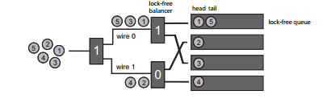
Intro

Slide 8
Intro

Slide 9
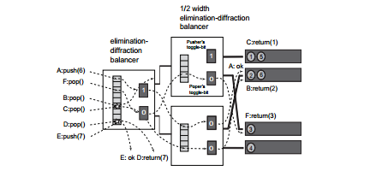
Intro

Slide 10
Implementation

Slide 11
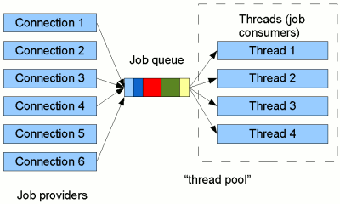
Implementation: Thread Pool

Slide 12
Implementation

Slide 13
Implementation

Slide 14
Implementation

Slide 15
Testing: Test Platform
Toshiba Satellite S55-A5295 laptop
i7 Quad Core processor
8 logical cores
12 gigabytes of DDr3 RAM
Windows 10
Task manager only other application running

Slide 16
Testing: Methodology
24 Test Cases (experimental and control, 500,000 ops each, varied load distributions and thread counts)
Collect data on time and throughput for each test case
40 Trials each, to be able to eliminate extreme values and maintain a statistically significant sample size
Eliminate extreme values to control for confounding variables like garbage collection and processor contention
Collect means

Slide 17
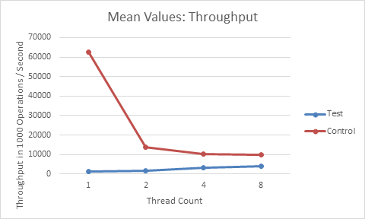
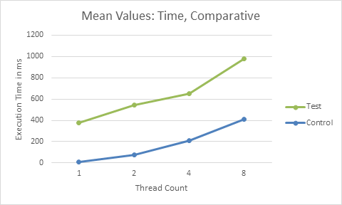
Testing: Experimental vs. Control

Slide 18
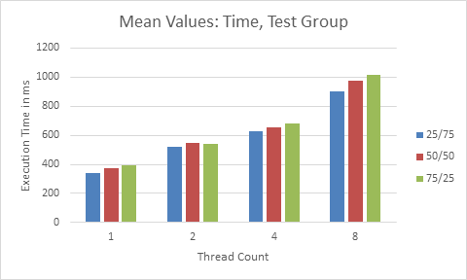
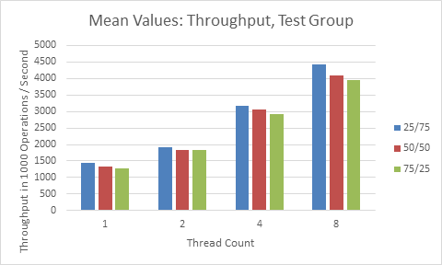
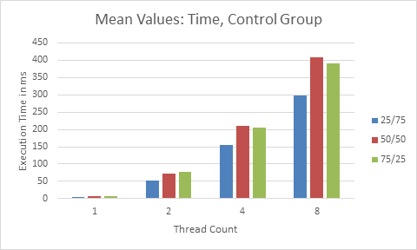
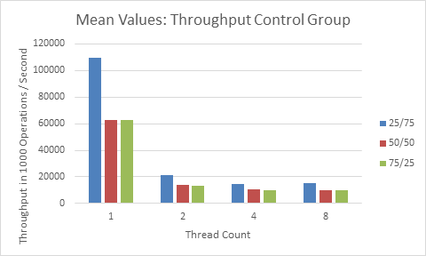
Testing: Data Breakdown

Slide 19
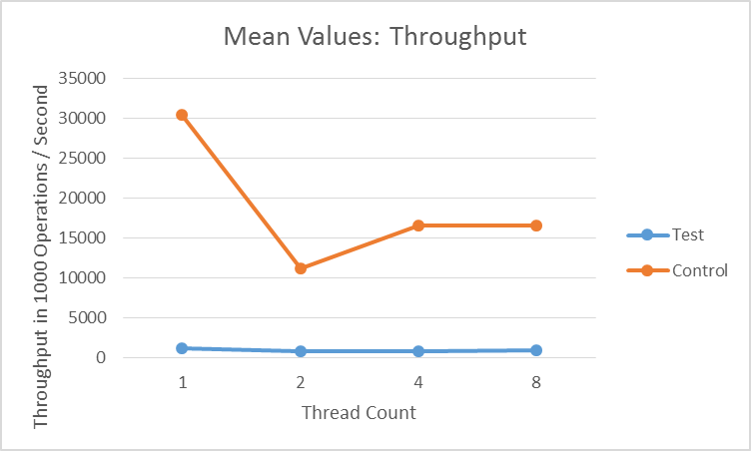
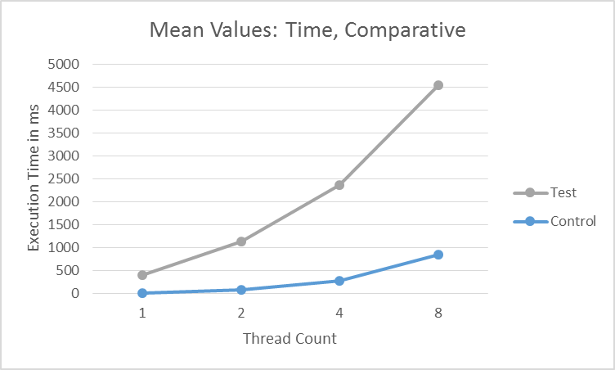
Testing: Concurrent vs. Sequential

Slide 20
Questions?

